Slide 1
LECTURE 10

Slide 2
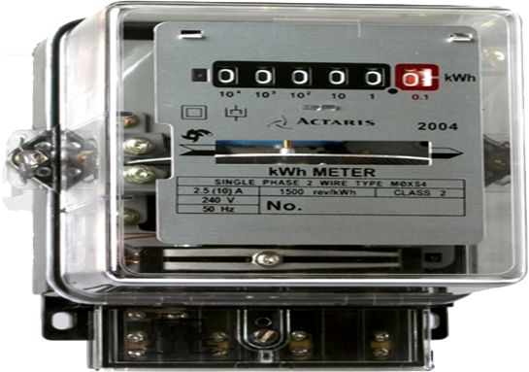
Electric power is the rate at which electric energy is dissipated or consumed in an electric circuit
work
Relation between Commercial & S.I. unit of work
Power
=
time
kWh
Energy consumed
Electric power
=
time
1kW h
=
1000 W × 3600 s
What is kWh
Energy consumed
=
×
1kW h
=
36 × 10⁵ W - S
Power
time
kW h
=
36 × 10⁵ joule
1
Unit of electric
energy
1kW h = 3.6 × 10⁶ J
=
watt
×
second
Energy consumed in bigger units
=
1
kW
×
1
h
Electric Meter
1 Unit

Slide 3



Type - E
$$\frac{\text{Energy} \text{Consumed}}{\text{time} \text{in} \text{hours}}$$
Electric Power
=
numerical
Note : Electric power should be in kilowatts & time should be in hours

Slide 4
1
An electric refrigerator rated 400 W operates 8 hour/day. What is the cost of the energy to operate it for 30 days at Rs 3.00 per kWh?
Given :
400
Power (P) = 400 W
=
Ans :
kW
=
0.4 kW
1000
Time (t) = 30 × 8h = 240 h
The cost of energy to operate the refrigerator for 30 days is Rs. 288
Cost per kWh = Rs 3
To find :
Energy consumed = ?
Formulae :
Energy consumed
=
P
×
t
Solution :
Energy consumed
= P
×
t
Energy consumed
=
0.4 kW
×
240 h
Energy consumed = 96
kWh
Cost of energy
=
96
×
3
Cost of energy = Rs. 288

Slide 5
2
An electric heater rated 1000W / 220V operates 2 hours daily. Calculate the cost of energy to operates for 30 days at Rs. 3 per kWh.
Given :
Power (P)
=
1000W
=
1 kW
Time (t)
=
2 h/day
To find :
Cost of energy to operate for 30 days = ?
Formula :
Energy consumed
=
P × t
Solution :
Energy consumed by electric heater
=
P × t
=
1 kW × 2h
=
2 kWh
Cost of energy to operate
=
2 × 3
=
Rs. 6 per day
Cost of energy to operate for 30 days
=
30 × 6
=
Rs. 180
Ans :
Cost of energy to operate electric heater for 30 days is Rs. 180

Slide 6
3
A 100 watt electric bulb is lighted for 2 hours daily and four 40 watt bulbs are lighted for 4 hours everyday. Calculate the energy consumed.
100
Given :
Power (P₁)
= 100 Watt
=
0.1 kW
Energy consumed
=
4 ×
P₂ × t₂
kW
time (t₁)
1000
= 2 hours
=
4 × 0.04 kW × 4 h
40
Power (P₂)
= 40 Watt
=
0.04 kW
kW
1000
=
0.64 kWh
time (t₂)
= 4 hours
To find :
Energy consumed in each case?
Energy consumed by four 40 watt bulbs in one day is 0.64kWh
Formula :
Energy consumed
=
Power × time
Solution :
Energy consumed
=
P₁ × t₁
Total Energy consumed
=
0.2 +
0.64
=
0.1 kW × 2 h
=
0.84kWh
=
0.2kWh
Energy consumed by 100 watt bulb in one day is 0.2kWh
Ans :
Total Energy consumed is 0.84kWh

Slide 7
4
Which uses more energy, a 250 W TV set in 1 hr, or a 1200 W toaster in 10 minutes ?
250
Energy consumed by 1200 W toaster in 10 min
=
Given :
Power (P₁)
= 250 W
=
0.25 kW
P₂ × t₂
kW
1000
1200
Power (P₂)
= 1200 W
1.2 kW
=
kW
=
1.2 kW × 0.167 h
1000
Time (t₁)
= 1 h
=
0.2 kWh
Time (t₂)
= 10 min
10
Ans :
=
h
60
Energy consumed by a 250 W TV set in 1 hr is more than the energy consumed by a 1200 W toaster in 10 minutes
= 0.167 h
To find :
Energy consumed = ?
Formula :
Energy consumed
=
Pt
Solution :
Energy consumed by a 250 W TV set in 1 h
=
P₁ × t₁
=
0.25 kW × 1h
=
0.25 kWh

Slide 8
5
A household uses the following electric appliances :
Refrigerator of rating 400W for ten hours each day
Two electric fans of rating 80W for 12 hours each day
Six electric tubes of rating 18 W each for 6 hours each days
Calculate the electricity bill of the household for the month of June. If the cost per unit of electric energy is Rs. 5.00 per kwh
Power (P₁)
=
400W
t₁
=
Given :
0.4 kW;
10 h/day
Energy consumed by two electric fans
=
2 × P₂ × t₂
=
2 × 0.08 × 12
Power (P₂)
=
80W
t₂
=
1.92 kWh
0.08 kW;
=
12 h/day
Power (P₃)
=
18W
t₃
Energy consumed by six electric tubes
=
6 × P₃ × t₃
=
0.018 kW;
6 h/day
=
6 × 0.018 × 6
0.648 kWh
Cost per unit of electric energy
=
=
Rs. 5.00
Total electrical energy consumed
=
4 + 1.92 + 0.648
To find :
Electricity bill of household = ?
=
6.568 kWh
Total electrical energy consumed in month of June (30 days)
Formula :
Energy consumed
=
P × t
E = 6.568 kWh × 30
Solution :
Energy consumed by refrigerator
=
P₁ × t₁
=
197.04 kWh
=
0.4 × 10
Electricity bill of household for month of June is Rs. 985.20
=
197.04 × 5
∴ Electricity bill of operation
Ans :
=
4 kWh
=
Rs. 985.20

Slide 9
Thank You

